Slide 1
Handle
Radio Buttons

Slide 2
What is a Radio Buttons?
Radio buttons let users select only one option from a group.
All radio buttons in the same group share the same name attribute.
In React, we manage which one is selected using state.

Slide 3
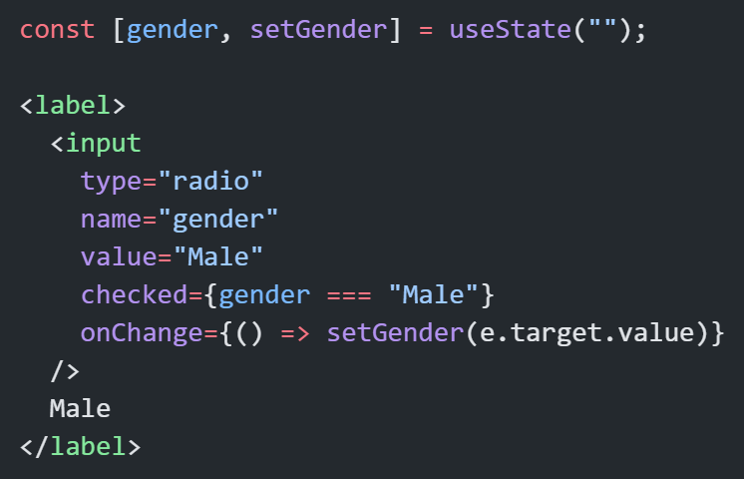
Basic Radio Button

Slide 4
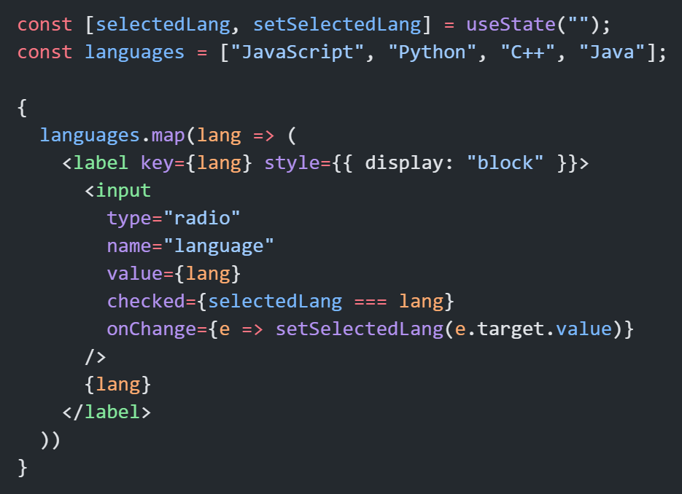
Grouping Radio Buttons
If you have multiple options, map them dynamically instead of repeating code.

Slide 5
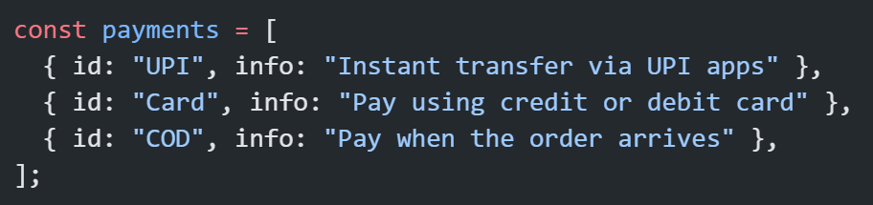
Summary:
Concept | Description | Example
name | Groups radios | All radios share same name
value | Defines option | value="Male"
checked | Determines selected | checked={gender==="Male"}
onChange | Updates state | setGender(e.target.value)
useState | Controls selection | const [gender, setGender] = useState("")
Q. Imagine you have a list of payment options and want to display details for the selected one.

Slide 6
Thank You

